Slide 1



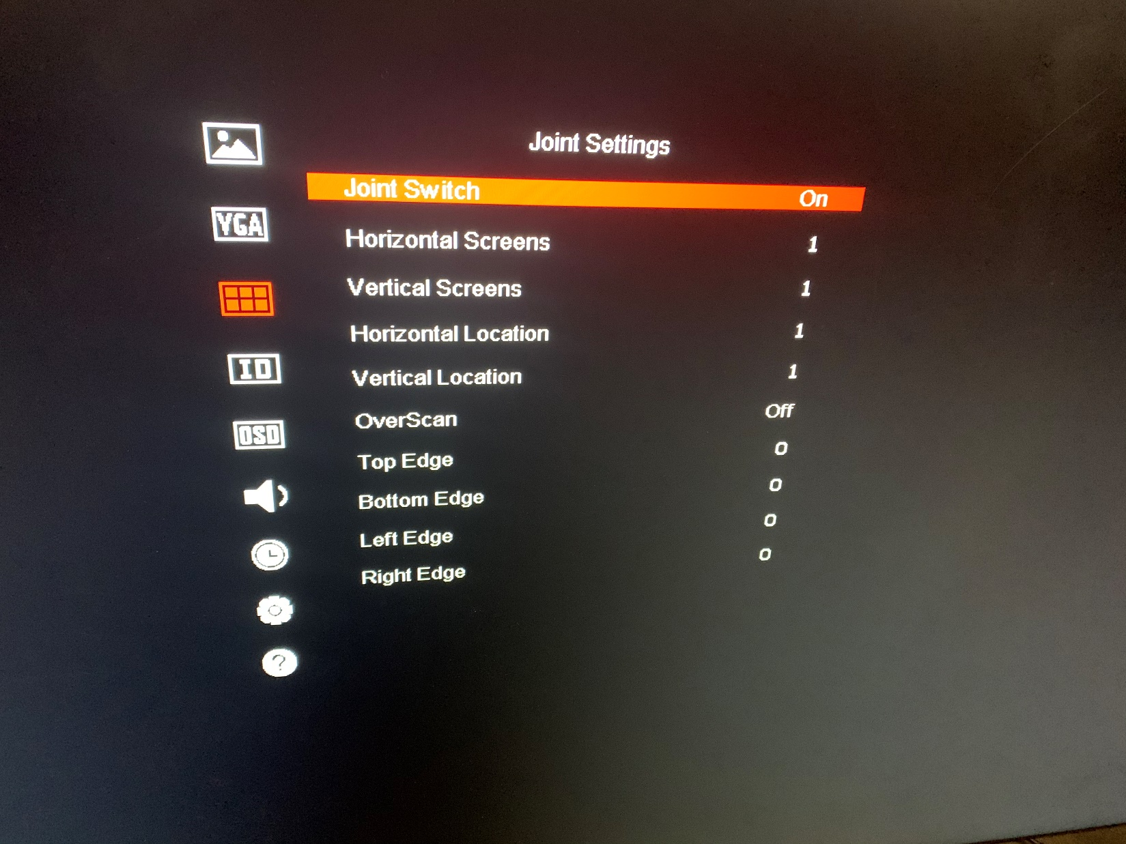
How to configure the self-splicing of LCD
Introduction:
LCD support self-splicing function
You need to connect video cable one by one
Here’s a configure guide
Configuration Steps:
Connect video cable one by one, follow the rules of out-in-out-in-…-in.
OUT
OUT
IN
IN
OUT
IN
Please confirm the interface of the device. Only LCD with video output ports support self-splicing.
Use remote control to select the screen and turn on the self-splicing function
Press IDSEL to call the ID number of LCD. Press the numbers accordingly to select certain screen, e.g. press 0101 to select the screen with ID 0101, once selected successfully, the ID number of that screen will turn red
Then press MENU button, find Joint Switch function and enable it.
note: each LCD needs to turn on the self-splicing function.
Set the screen size and the coordinates of each screen
Horizontal Screens and Vertical Screens input the number of horizontal and vertical screens. Such as 2*2 or 4*3
Fill in the horizontal and vertical location according to the position of the screen installation.
Number sequence, from bottom to top, from left to right, increasing sequentially.
Screen 3
1,2
Screen 4
2,2
Screen 1
1,1
Screen 2
2,1
For example, in setting screen 3, need to fill in 1 for the horizontal location and 2 for the vertical location.
After all screens are set up, the self-splicing function completes the setting.
Let’s ,make a conclusion
Connect video cable one by one.
Enable self-splicing function.
Set the scale and position of each screen
Each of the above steps is important

