Slide 1
DS-K3B631TX Series Swing Barrier
Delivery Guide
Bill Yu Feb 9 2023

Slide 2
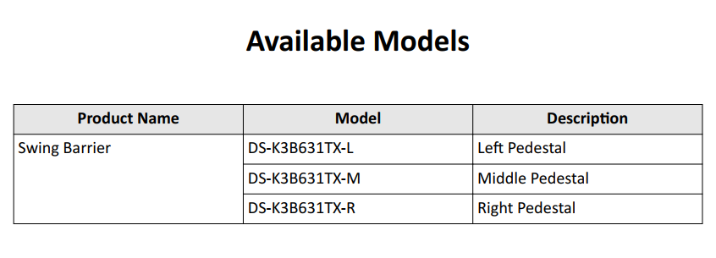
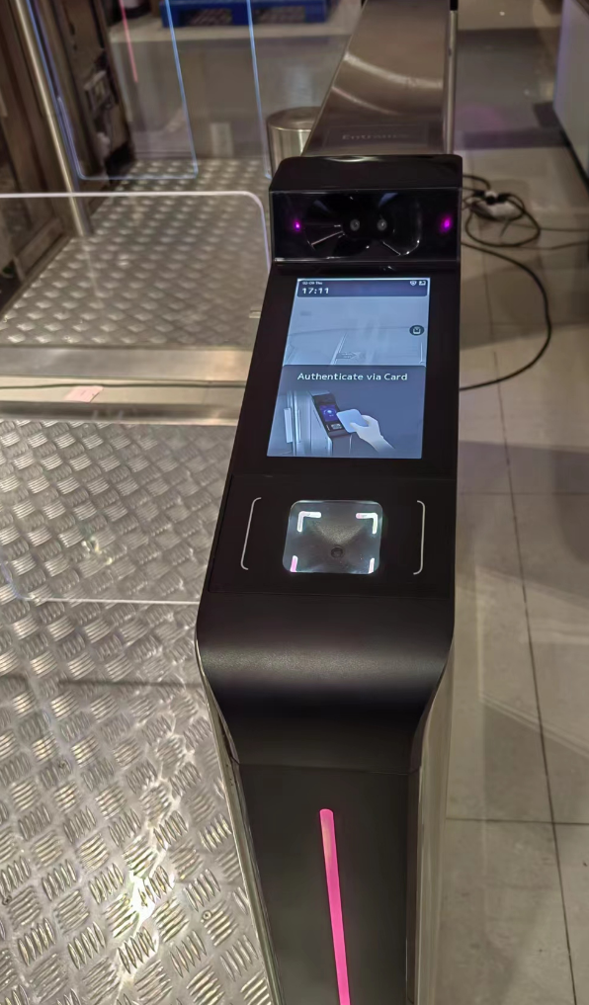
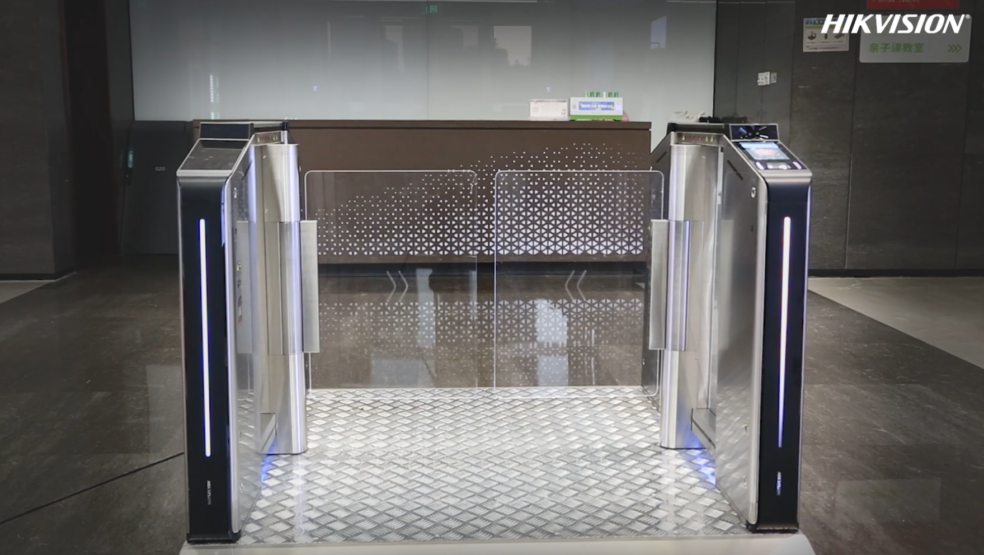

Slide 3

CONTENTS
01 System Wiring
02 Installation and Wiring
03 Components Introduction
04 Activation and Test
05 Appendix

Slide 4


P.01
System Wiring

Slide 5


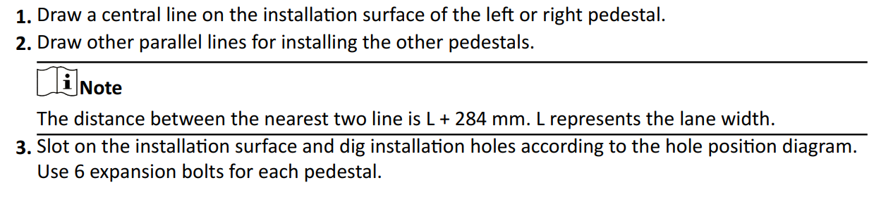
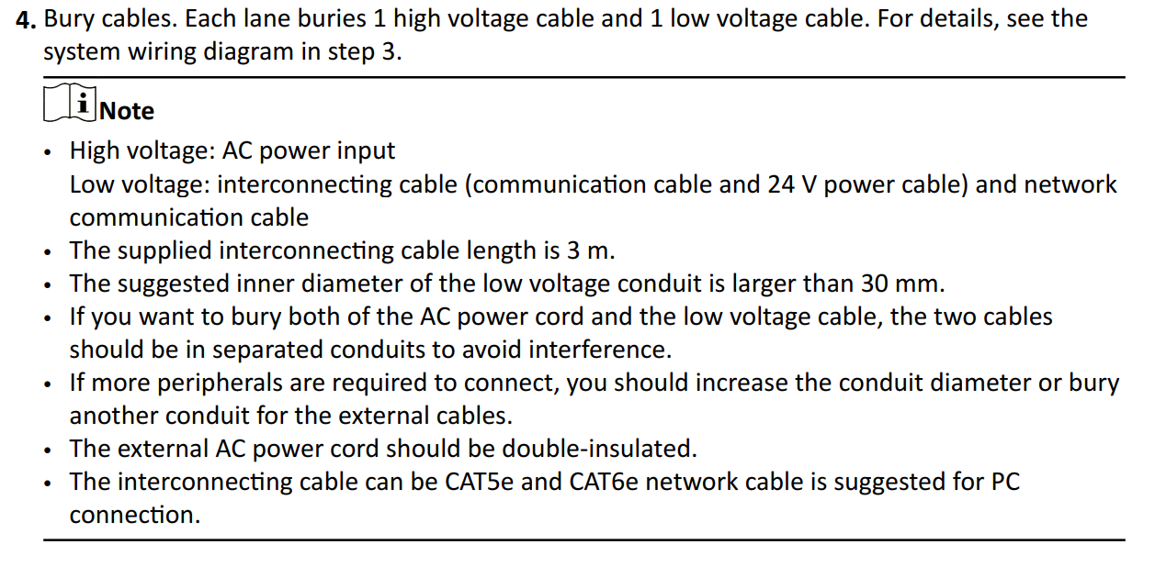
System Wiring
The preparation before installation and general wiring.

Slide 6
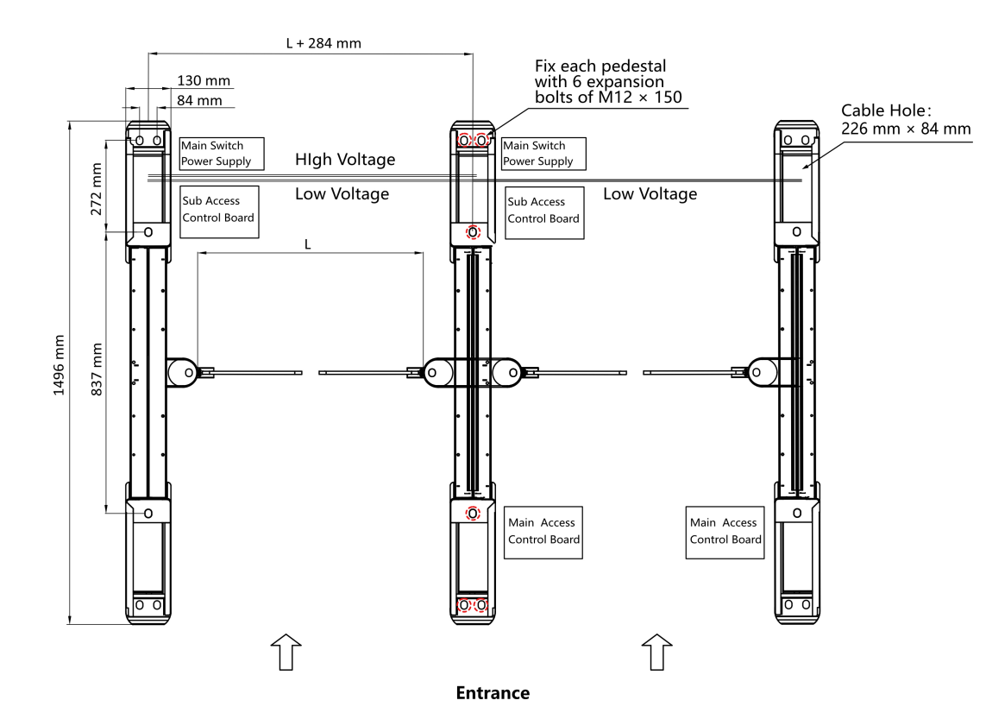
System Wiring
The preparation before installation and general wiring.

Slide 7
P.02
Installation and Wiring

Slide 8
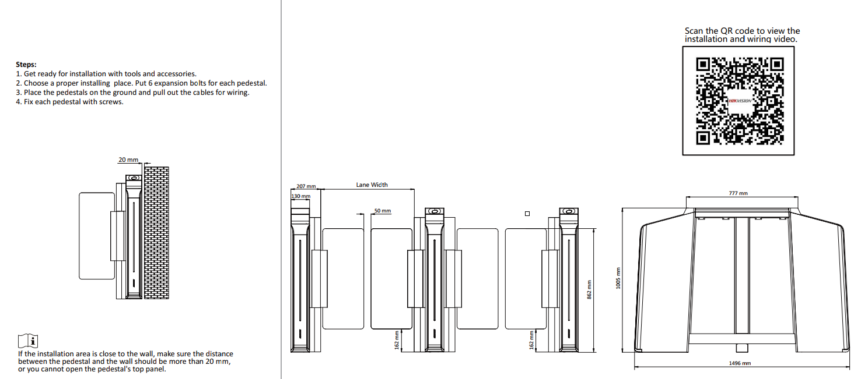
Installation and wiring

Slide 9
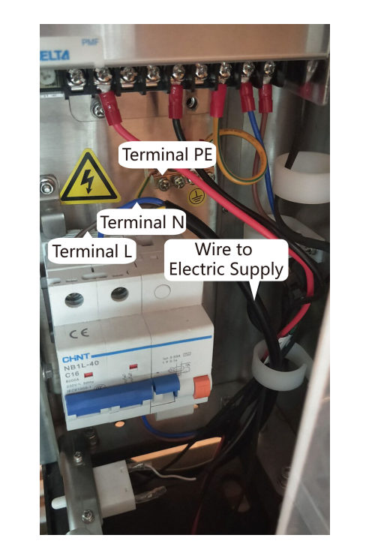
Installation and wiring
Wiring Electric Supply
Wire electric supply with the switch in the pedestal. Terminal L and terminal N are on the switch,
while terminal PE should connect to a ground wire (yellow and green wire).

Slide 10
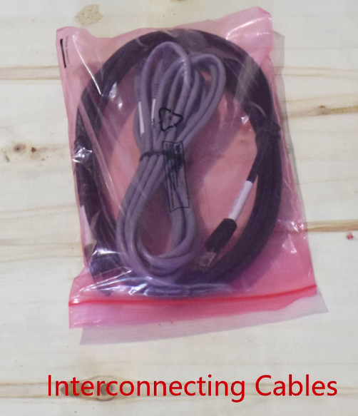
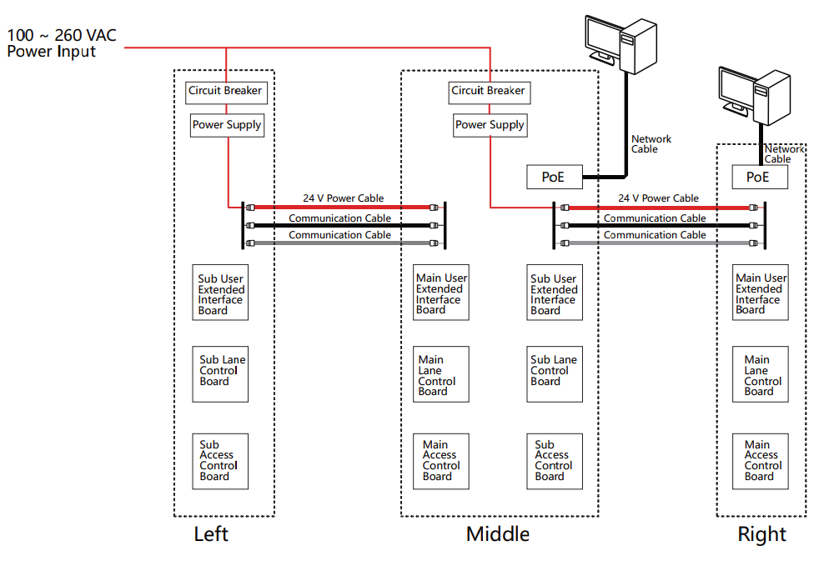
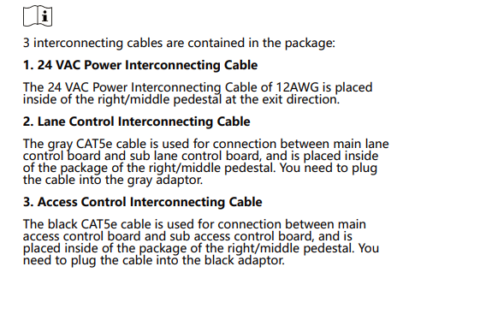
Installation and wiring
Wire Interconnecting Cable

Slide 11
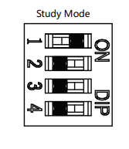
Installation and wiring
Set Study Mode
Enter the study mode through DIP switching to set the closed position of the device barrier.
Steps
1. Set The No.1 of the 8-digit DIP Switch on the main control board to ON by referring the
following figure to enter the study mode.
2. Adjust the closed position of the barrier.
3. Power on the device.
The device will remember the current position (closed position) automatically.

Slide 12
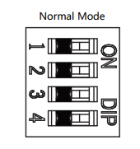
Installation and wiring
Set Work Mode
4. Power off the device.
5. Set the No.1 switches of the 8-digit DIP Switch on the main control board by referring
to the following figure.
6. Power on the device again.
Note
For details about the DIP switch value and meaning, see DIP Switch Description.
The barrier will open automatically and turns back to the closed position. At this circumstance,
the device enters the normal mode.

Slide 13
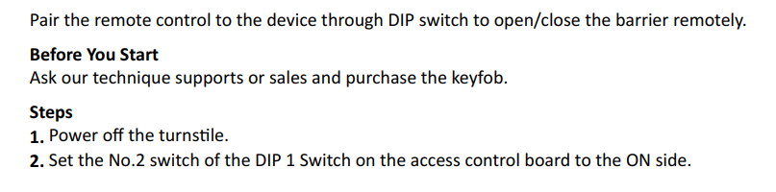
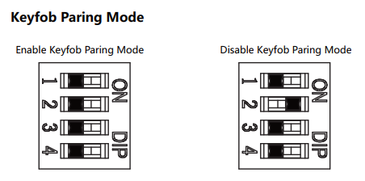
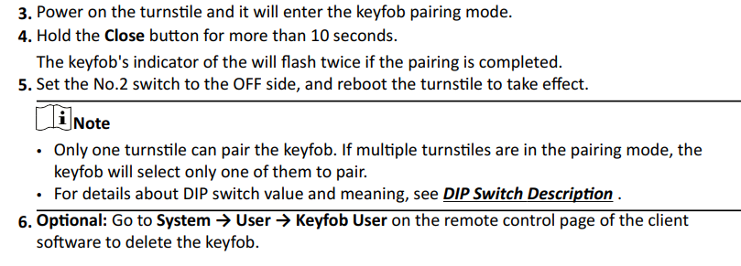
Installation and wiring
Pair Keyfob (Optional)

Slide 14
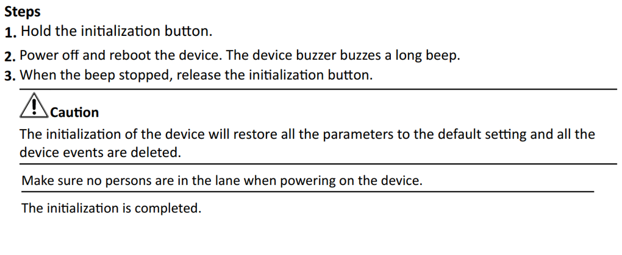
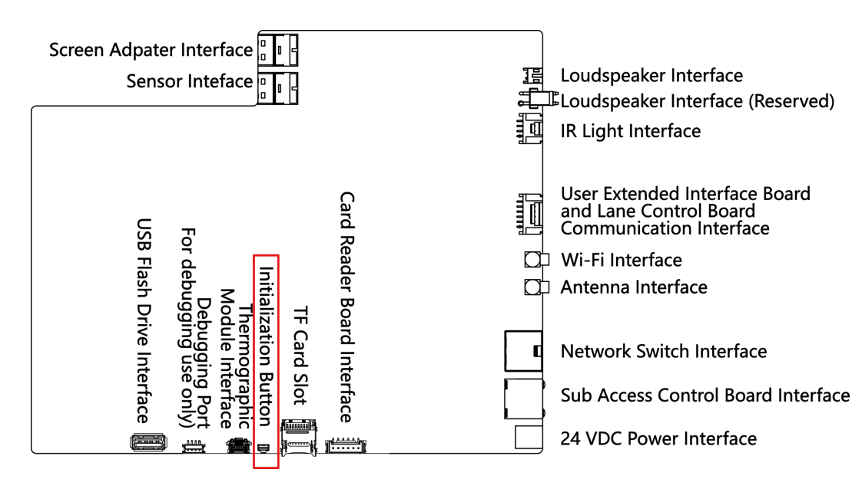
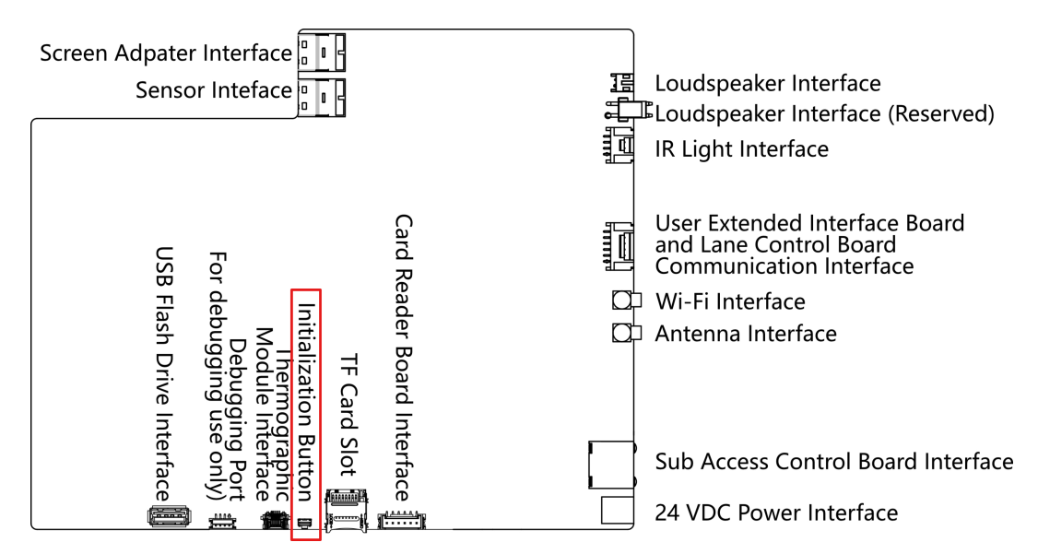
Installation and wiring
Initialize Device

Slide 15
P.03
Components Introduction

Slide 16
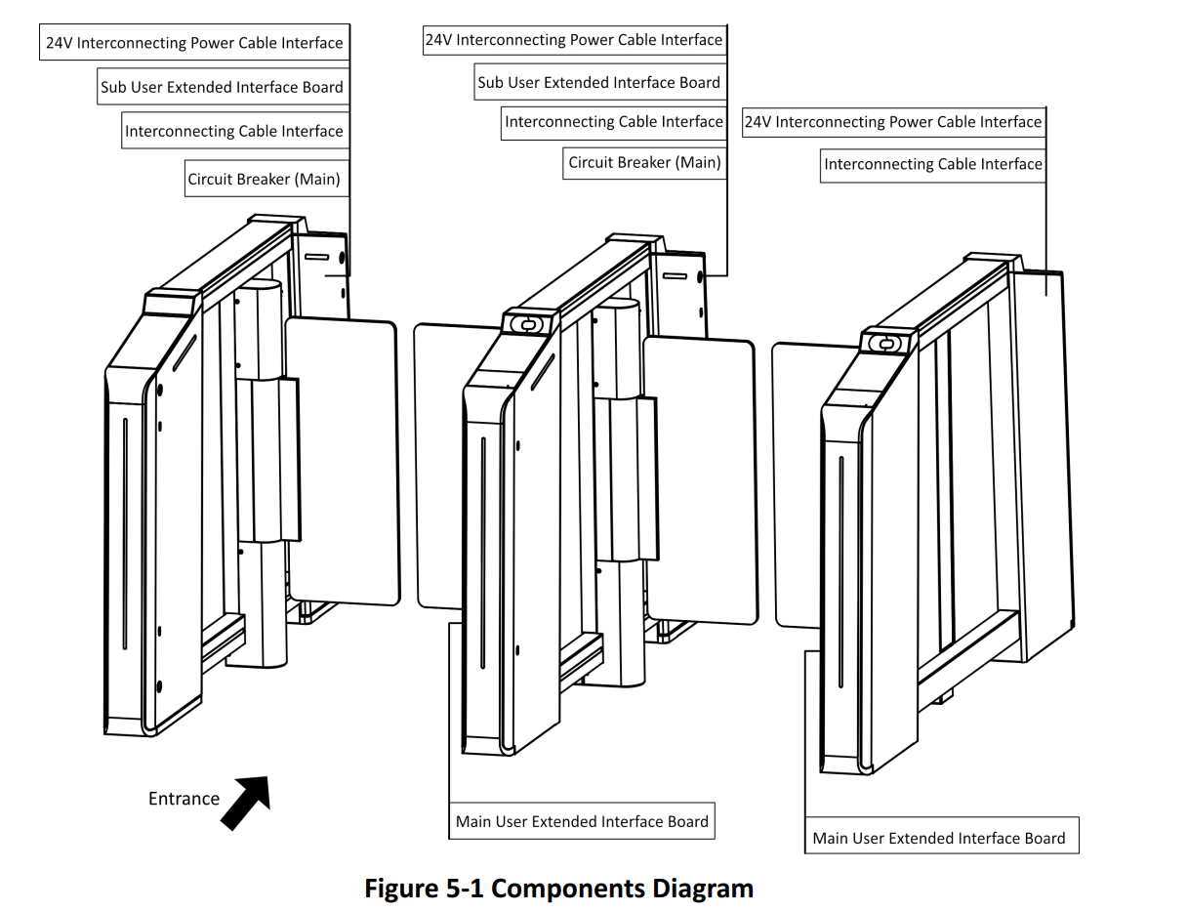
01
Components Introduction
Components Introduction
By default, basic components of the turnstile are connected well. The pedestals can communicate by wiring the interconnecting cables. And the turnstile supports wiring the AC electric supply forthe whole system’s power supply.

Slide 17
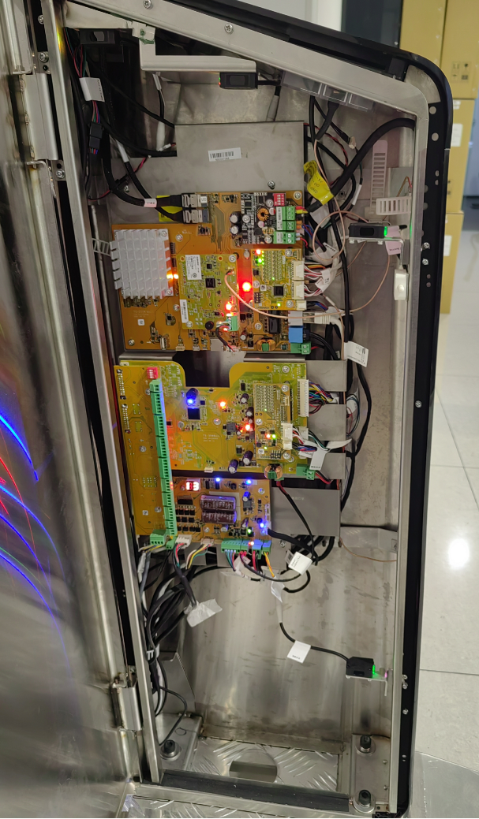
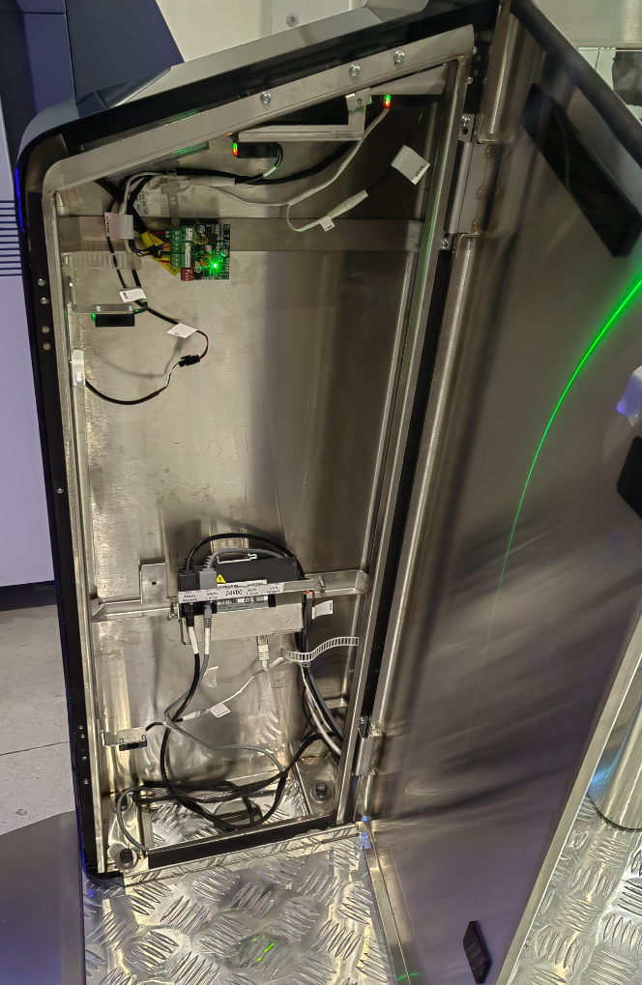
01
Components Introduction
Main Lane overview

Slide 18
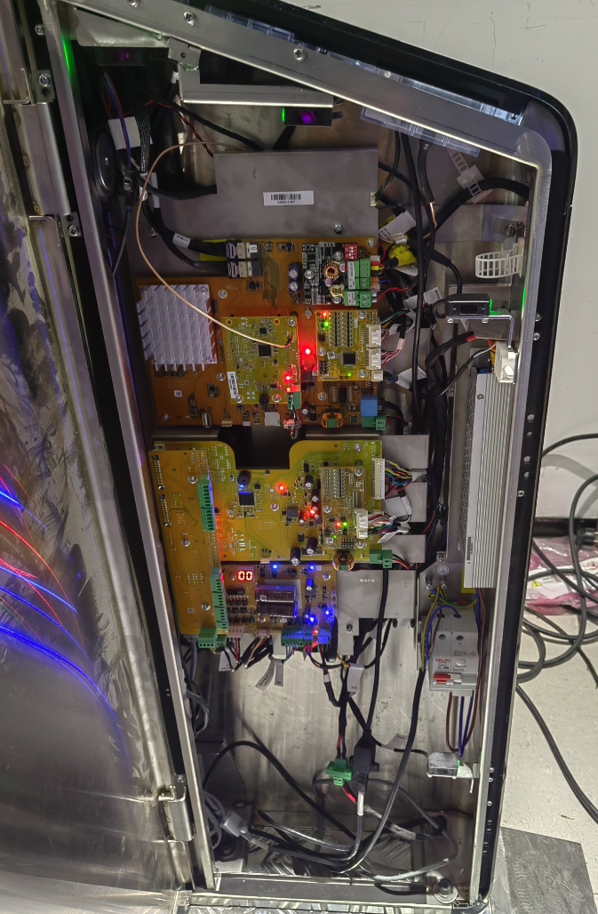
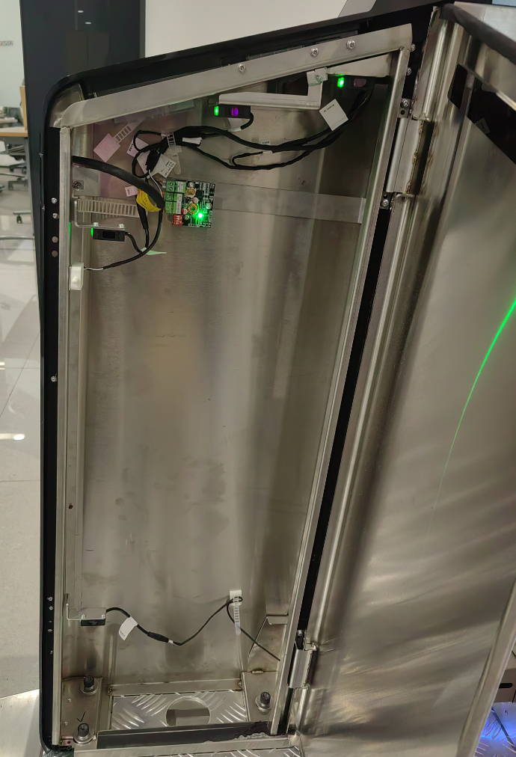
01
Components Introduction
Sub Lane overview

Slide 19
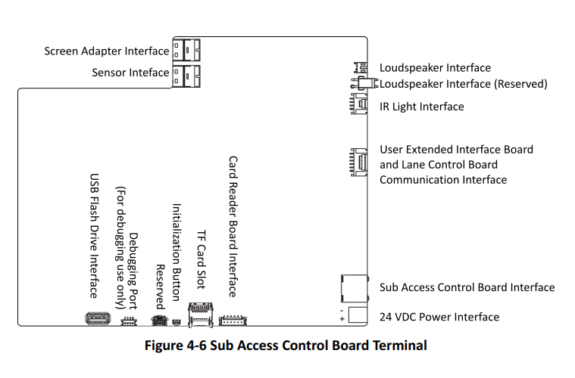
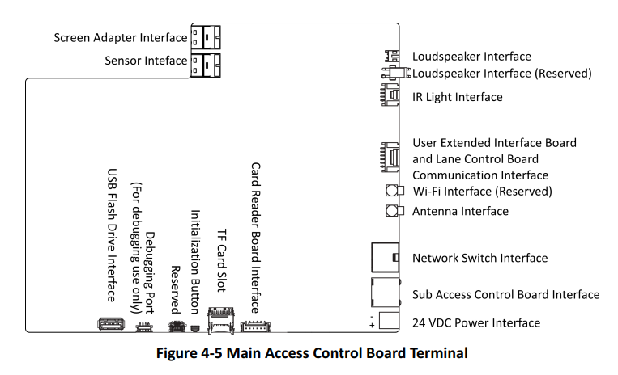
01
Components Introduction
Access Control Board
The access control board contains screen adapter interface, sensor interface, loudspeaker interface, IR light interface, user extended interface board and lane control board communication interface, antenna interface, network switch interface, sub access control board interface, power interface, card reader board interface, TF card slot, initialization button, debugging port and USB flash drive interface.The picture displayed below is the main access control board diagram.

Slide 20
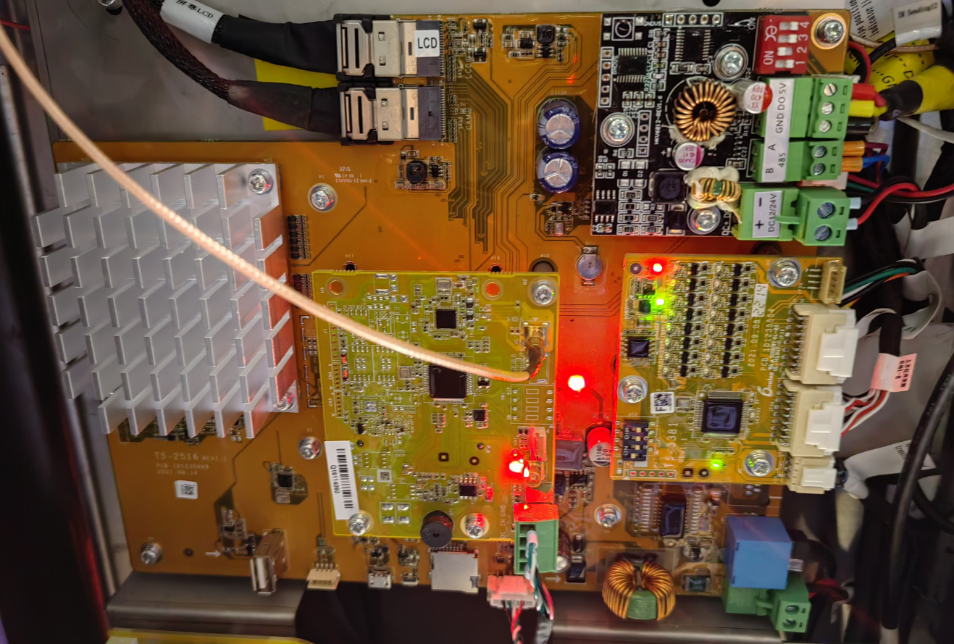
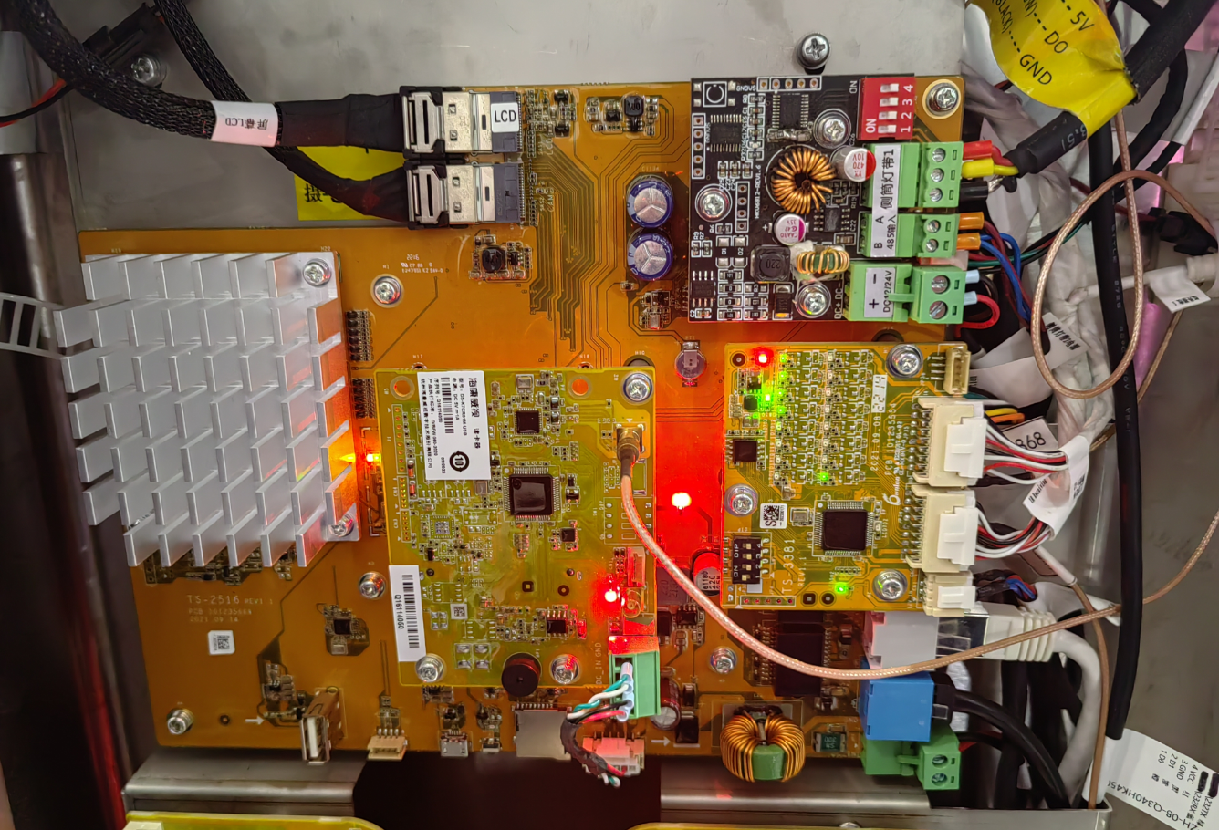
01
Components Introduction
Main Access Control Board Sub Access Control Board

Slide 21
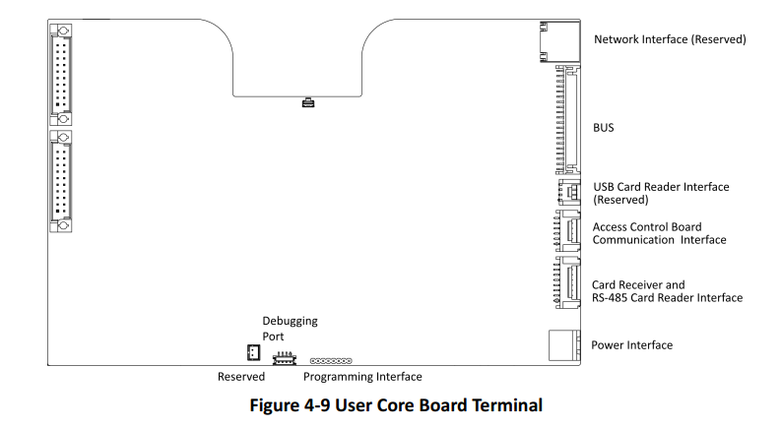
01
Components Introduction
Components Introduction
By default, basic components of the turnstile are connected well. The pedestals can communicate by wiring the interconnecting cables. And the turnstile supports wiring the AC electric supply forthe whole system’s power supply.

Slide 22
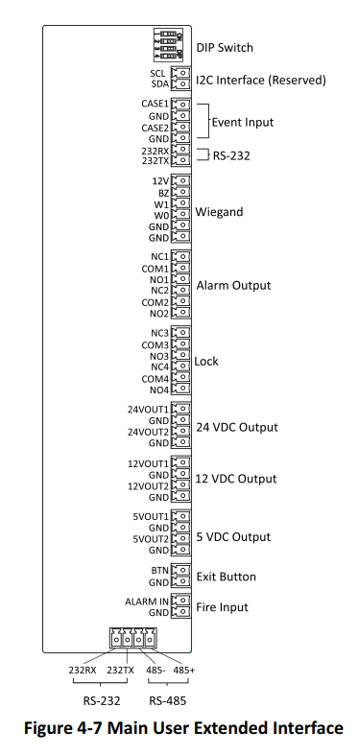
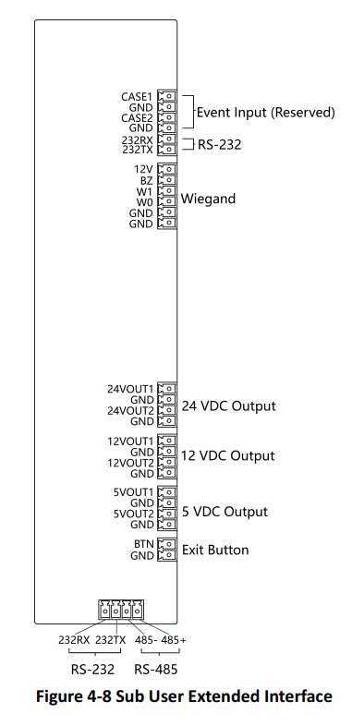
01
Components Introduction

Slide 23
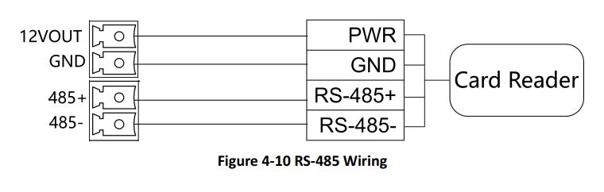
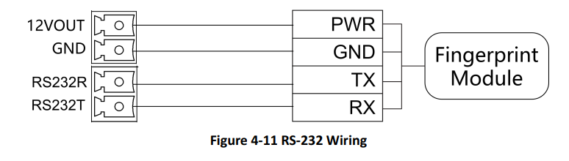
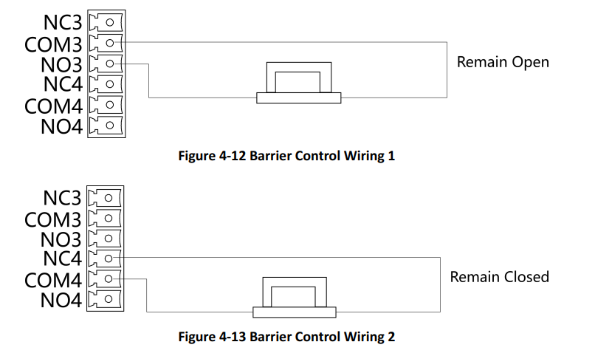
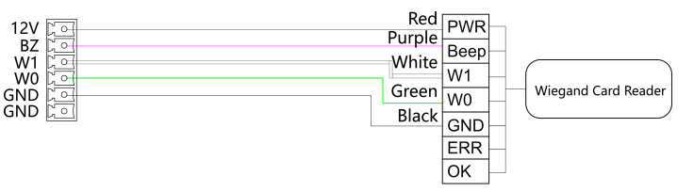
01
Components Introduction
Wiegand Wiring

Slide 24
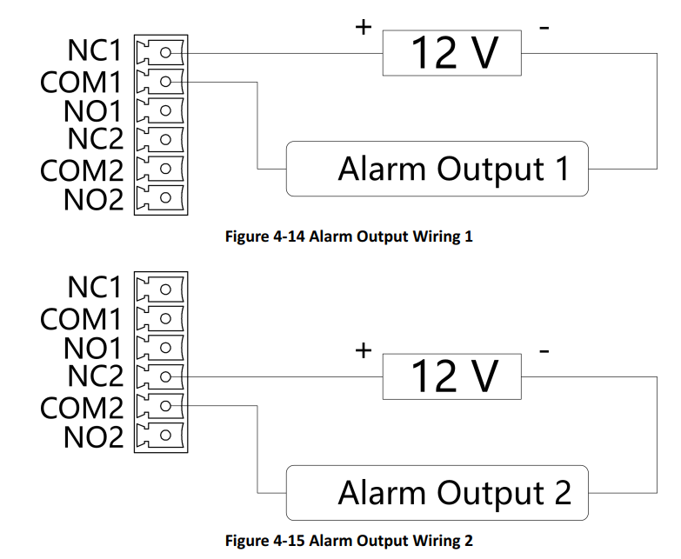
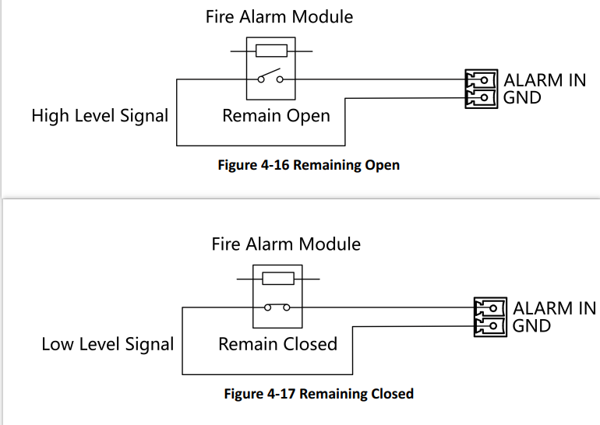
01
Components Introduction

Slide 25
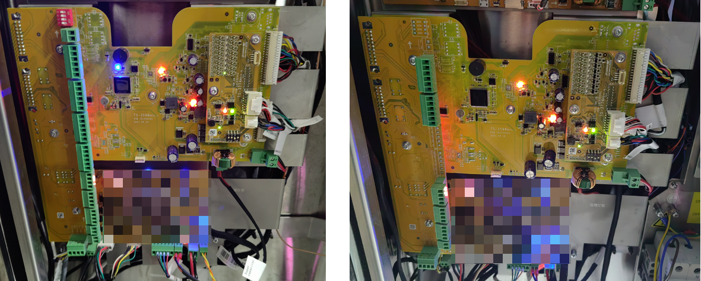
01
Components Introduction
Main User Extended Board Sub User Extended Board

Slide 26
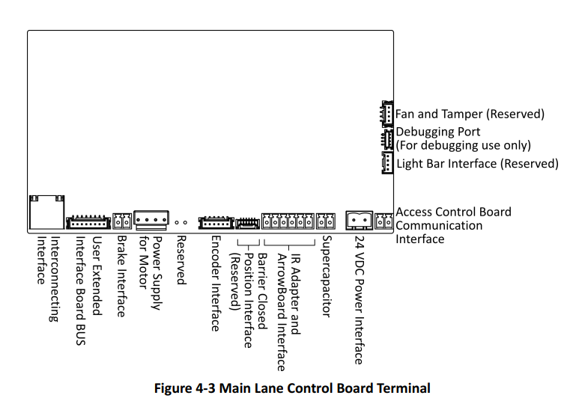
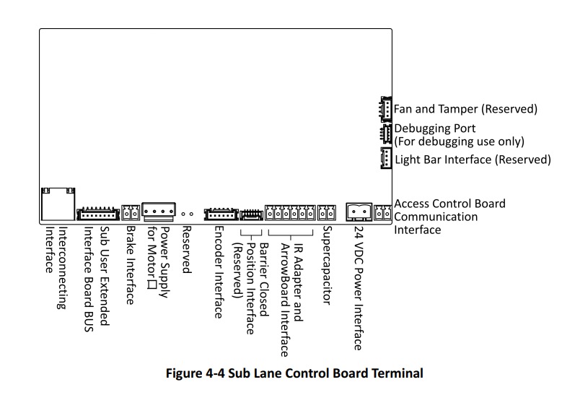
01
Components Introduction
Lane Control Board Terminal Description
The lane control board contains debugging port, access control board communication interface, power interface, supercapacitor, IR adapter and ArrowBoard interface, encoder interface, power supply for motor, brake interface, user extended interface board BUS, and interconnecting interface.The picture displayed below is the main control board diagram.

Slide 27
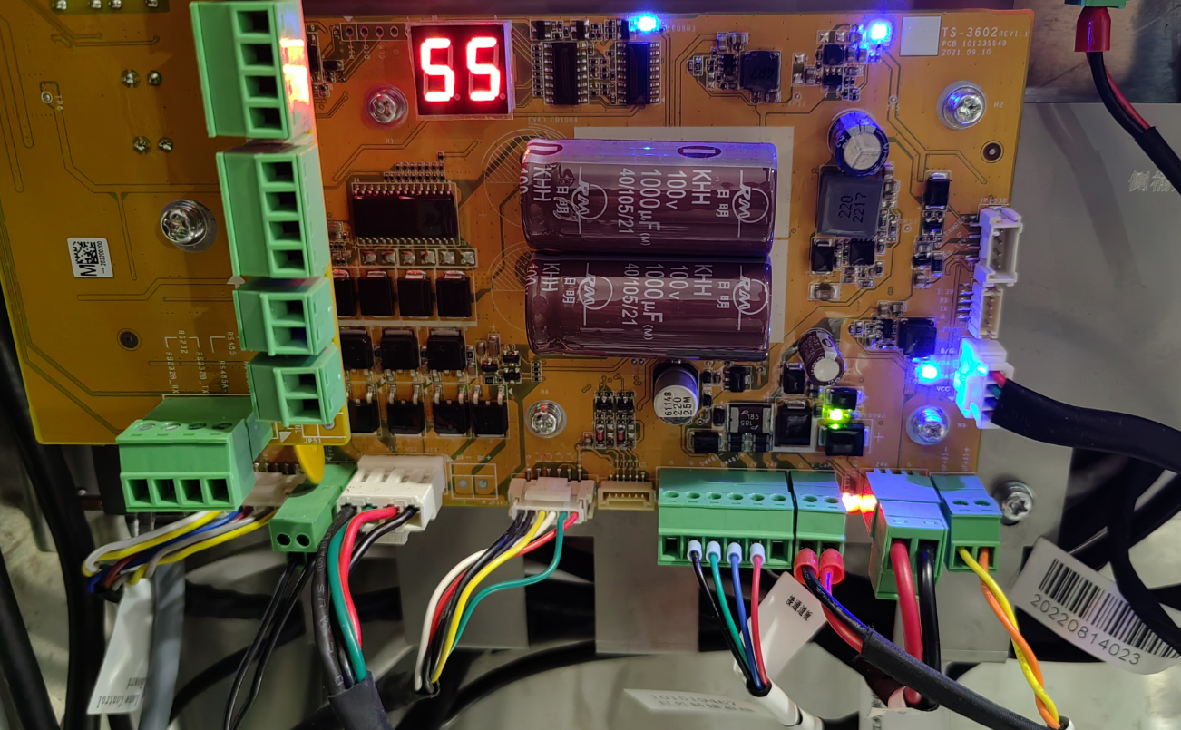
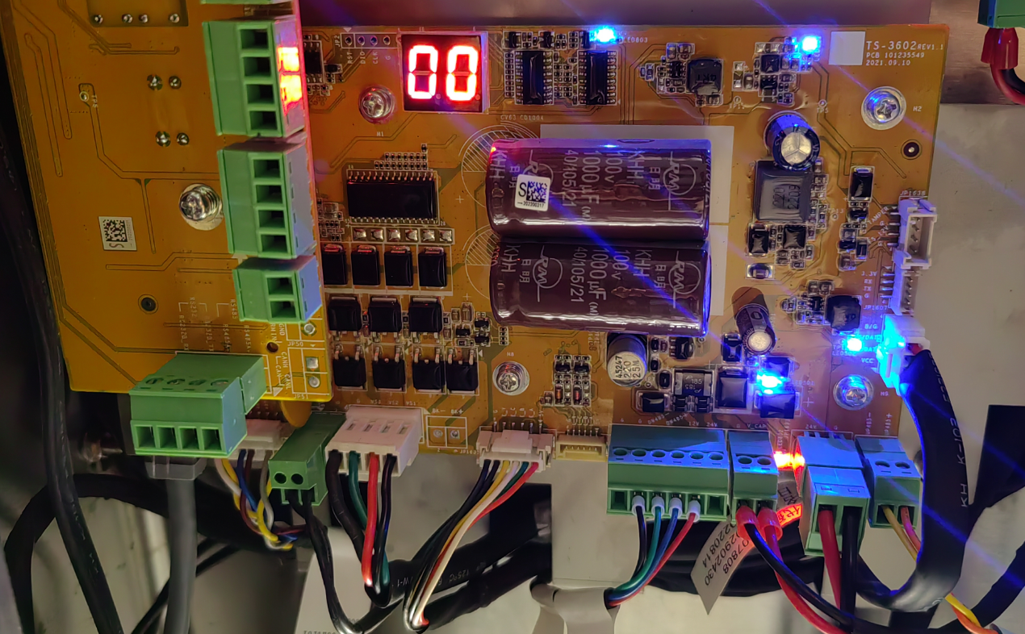
01
Components Introduction
Main Lane Control Board Sub Lane Control Board Terminal

Slide 28
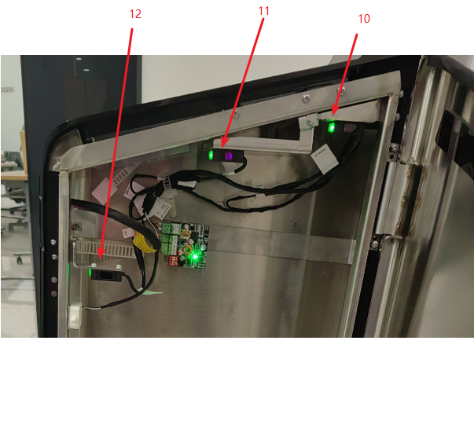
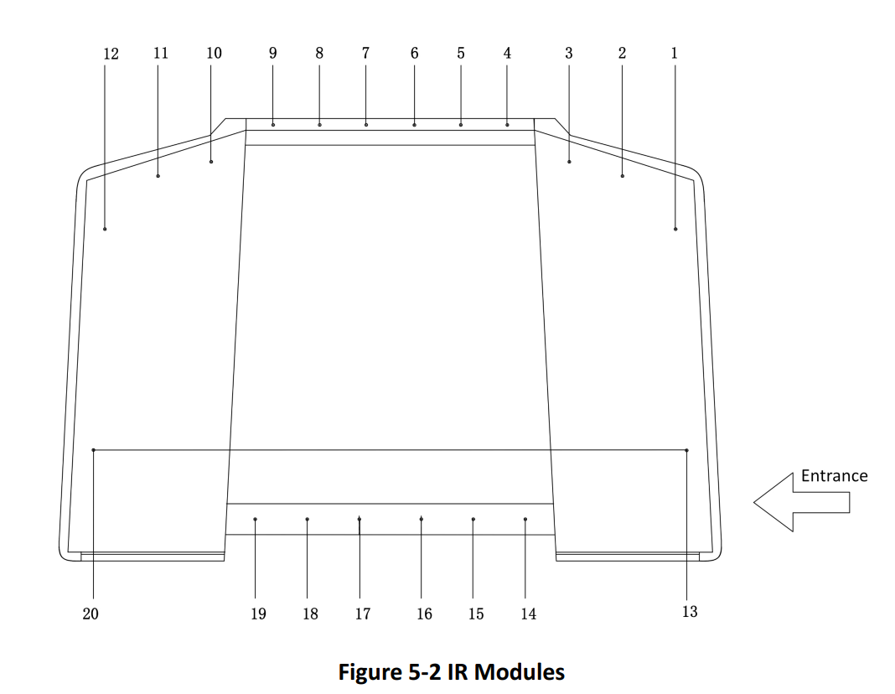
01
Components Introduction
IR Modules
The picture displayed below describes the IR adapter and the IR sending/receiving module and their corresponding number on the pedestal.
IR sending/receiving

Slide 29
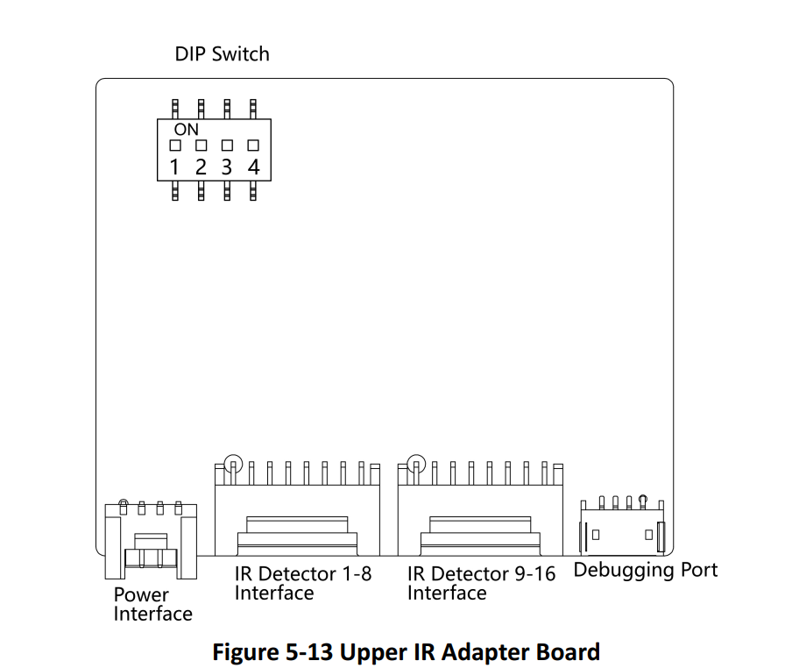
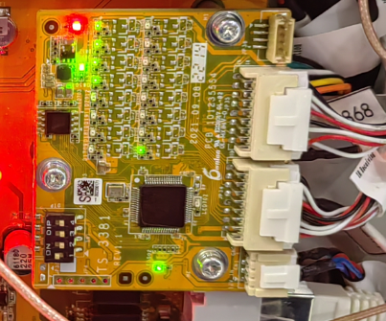
01
Components Introduction
Upper IR Adapter Board Terminal Description
Set DIP switch 1 to ON side.

Slide 30
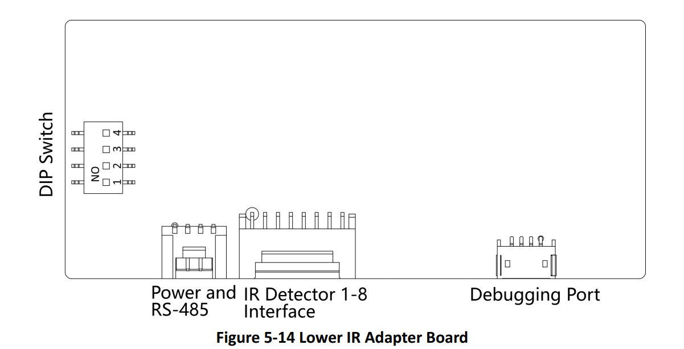
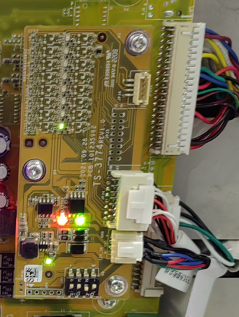
01
Components Introduction
Lower IR Adapter Board Terminal Description
Set DIP switch 2 to ON side.

Slide 31
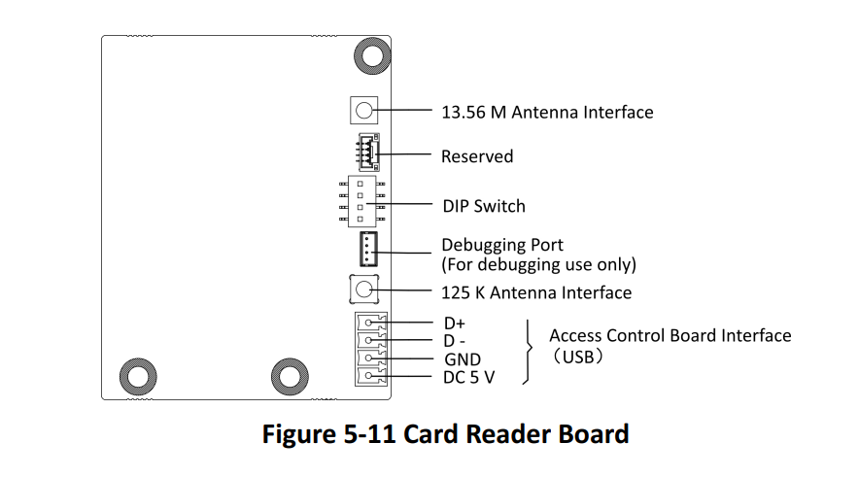
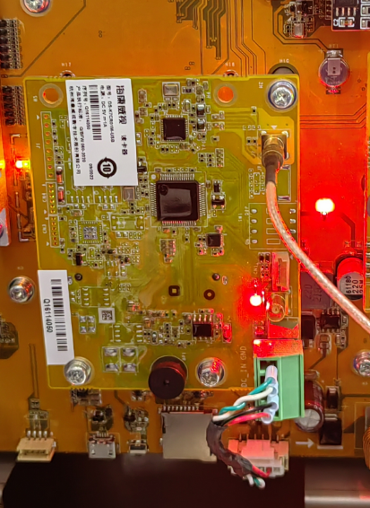

01
Components Introduction
Card Reader Board Terminal Description
The card reader board can be connected to the access control board via USB interface.

Slide 32



01
Components Introduction
Light Introduction

Slide 33



01
Components Introduction
Side Light Board

Slide 34

01
Components Introduction
Side Light Position

Slide 35
P.04
Activation and Test

Slide 36




01
Activation and test

Slide 37







01
Activation and test

Slide 38






01
Activation and test

Slide 39
P.05
Appendix

Slide 40

01
Appendix A. Tips When Collecting/Comparing Face
Picture

Slide 41


01
Appendix B. DIP Switch
The DIP swtich is on the main user extended interface board.

Slide 42


01
Appendix B. DIP Switch

Slide 43



01
Appendix C. Error Code Description
Picture

